Slide 1
ECE901 / CS838
Lecture 1
Large-scale Machine Learning
and Optimization

Slide 2
Intros
Instructor
Dimitris Papailiopoulos
dimitris@papail.io dimitris@ece.wisc.edu
Times
Tu. + Thu. @ 11:00 - 12:15pm
Student Hours:
Just send an email,
and we’ll arrange a mutually convenient time.
Webpage:
papail.io/901

Slide 3
Material
The course is based on recent books and text on ML, OPT and systems
Everything online:
papail.io/901
Books
Papers
Lecture Notes
Slides

Slide 4
Overview
Why Machine Learning?
Why Large-Scale?
Why Optimization?
What we will cover?
Who is this class for?
Grading

Slide 5
Why Machine Learning?

Slide 6
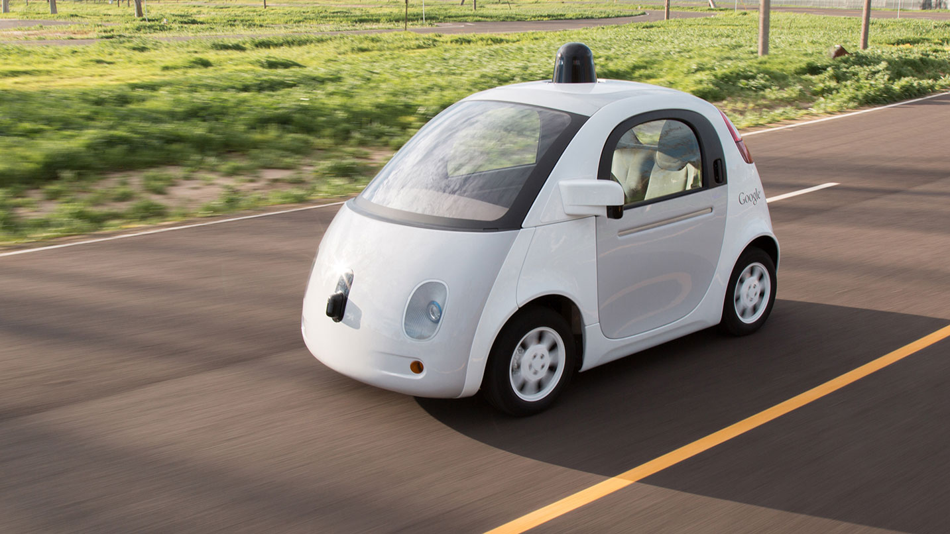
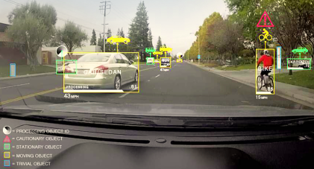
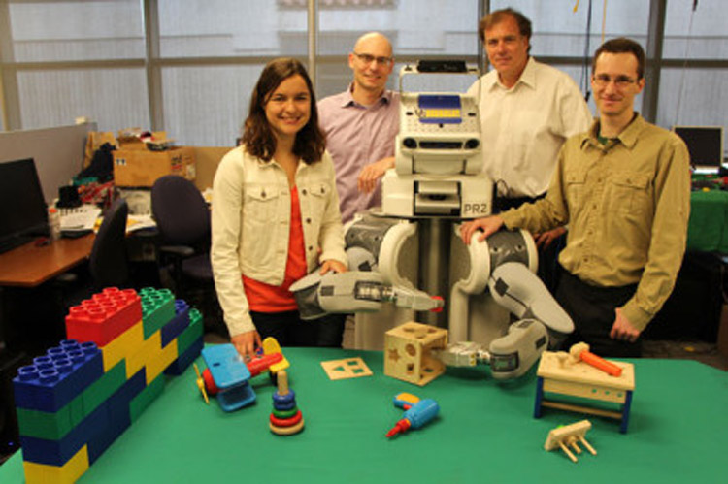



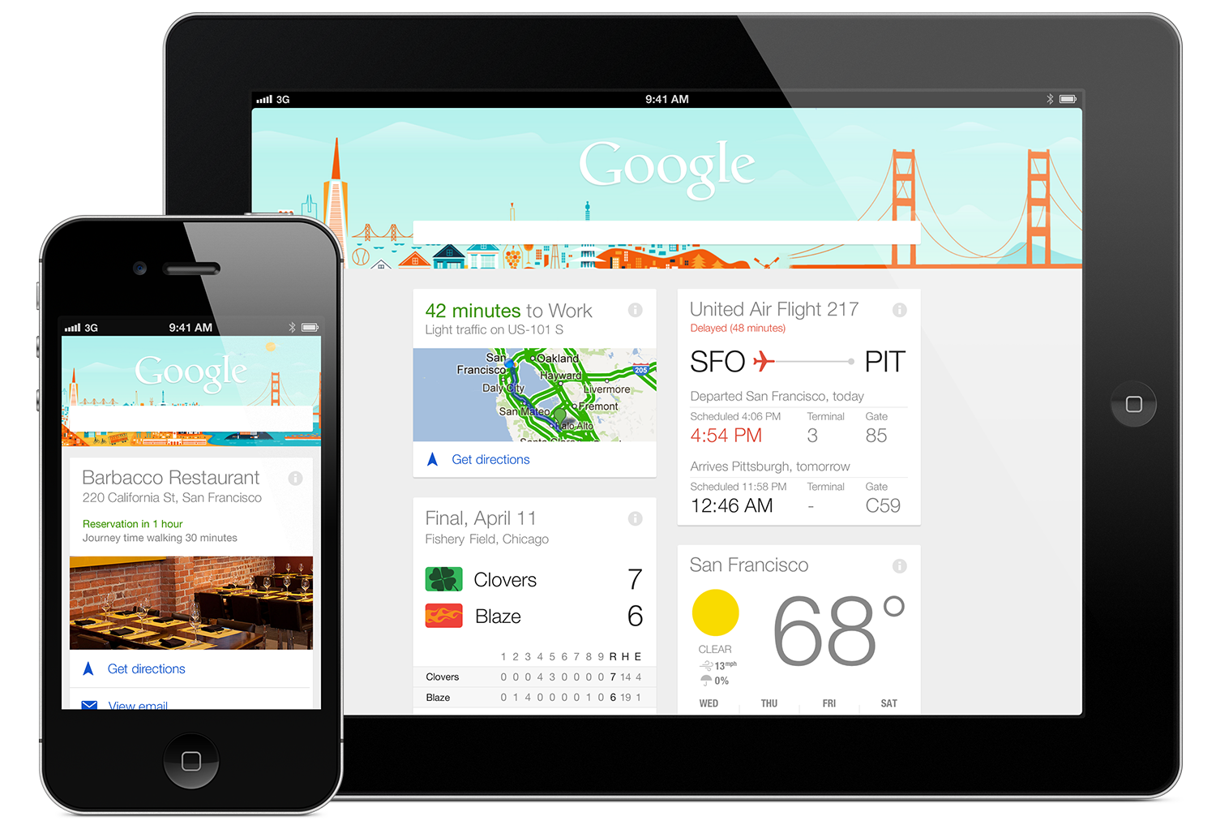
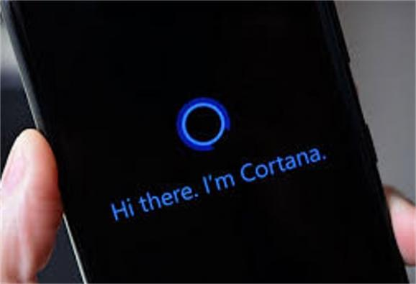



Automation and Robotics
Drug Discovery and Healthcare
Real and Important Problems
Intelligent Personal Assistants
Recommender Systems

Slide 7









Real Jobs

Slide 8
Why Large-scale?

Slide 9

Big Data is the Challenge
We have to handle large data sets
More than 800 photos uploaded / second
More than 8k tweets / second
More than 60K google searches / second
More than 2.5 million emails sent / second
[Source: http://www.internetlivestats.com/one-second/]

Slide 10
Why Optimization?
Small Detour
The Machine Learning Pipeline

Slide 11






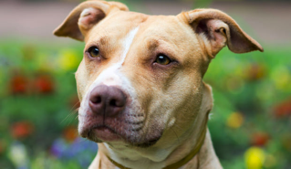
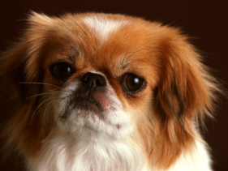

What is a “regular” ML pipeline?
Running example: image classification
Goal:
“train a computer to recognize a cat from a dog”

Slide 12
What is a “regular” ML pipeline?
Running example: image classification
Goal:
“train a computer to recognize a cat from a dog”
How?

Slide 13
What is a “regular” ML pipeline?
Running example: image classification
Goal:
“train a computer to recognize a cat from a dog”
How?
Simple idea, inspired by inductive human learning
Show it a lot of labeled examples
predictions of labels on unseen data

Slide 14
To this
From This

Slide 15
What is a “regular” ML pipeline?
Running example: image classification
Goal:
“train a computer to recognize a cat from a dog”
How?
Input Data

Slide 16
What is a “regular” ML pipeline?
Running example: image classification
Goal:
“train a computer to recognize a cat from a dog”
How?
Input Data
Training

Slide 17
What is a “regular” ML pipeline?
Running example: image classification
Goal:
“train a computer to recognize a cat from a dog”
How?
Input Data
Training
Model

Slide 18
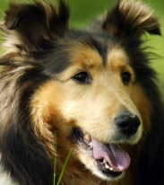
What is a “regular” ML pipeline?
Running example: image classification
Goal:
“train a computer to recognize a cat from a dog”
How?
Test (unseen) Data
Input Data
Training
Model
predicted
label:
“dog”

Slide 19
ML Pipelines
Test Data
Input Data
Feature
and Model Selection
Training
Model

Slide 20
ML Pipelines
Test Data
Input Data
Feature
and Model Selection
Training
Model

Slide 21
Feature Selection
Feature space
Pointy Ears
Size
Goal: Use “informative” features

Slide 22
Choose your predictor
(hypothesis class)
Goal: Pick a predictor that
1) Is expressive 2) is easy to train 3) doesn’t overfit

Slide 23
ML Pipelines
Test Data
Input Data
Feature
and Model Selection
Training
Model

Slide 24

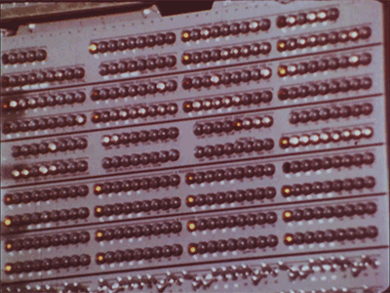
Now we train
Goal: Train a model to minimizes training error
Line = predictive model (classifier)
Ear Length
Snout Length

Slide 25
ML Pipelines
Test Data
Input Data
Feature Selection
Training
Model
Very large neural nets can take weeks to train
[DawnBench 2017]

Slide 26
Questions?

Slide 27
Why Optimization?

Slide 28
Training via Optimization
Many Problems in ML can be written as
Why?

Slide 29
The goal of Training
What we have: Labeled examples presented as (features, label)
E.g., features = image, label = “cat” (-1), or “dog” (+1)
Assumption:
all labeled (train/test) examples come from unknown distribution
+1

Slide 30
The goal of Training
What we have: n labeled examples drawn i.i.d. from
What we want: Train a model (a predictor function f )
That performs well on unseen data.

Slide 31
The goal of Training
What we have: n labeled examples drawn i.i.d. from
What we want: Train a model (a predictor function f )
That performs well on unseen data.
E.g.,
Our trained predictor

Slide 32
The goal of Training
How to measure performance?
Goal:
We want a predictor f with small loss on unseen data (e.g., on the test set)
Examples:
Cross entropy
Logistic loss
Measures disagreement between
predicted and true label
But, we haven’t seen… unseen examples

Slide 33
The goal of Training
The loss on the “unseen” examples converges to the expected loss
What else converges to the expected loss?
Note: More details in next lecture
Expected/True risk
Empirical risk

Slide 34
Training via Optimization
We want to solve:
We instead solve the ERM:
Note: More details in next lecture
e.g., F can be:
separating hyperplanes
NNs of depth-t
…

Slide 35
Training via Optimization
More often than not, we minimize the empirical risk through
Note: Several examples in next lecture.
Measures model fit
for data point i
(avoids under-fitting)
Measures model
“complexity”
(avoids over-fitting)

Slide 36
Questions?

Slide 37
Scalability

Slide 38
Solvability ≠ Scalability
Many of the problems that we visit, can be solved in polynomial time, but that’s not enough.
E.g.,
O( #examples^4 * dimension^5 ) not scalable
We need fast algorithms!
Ideally O(#examples * #dimension) time
We want algorithms amenable to parallelization!
if serial runs in O(T) time, we want O(T/P) on P cores.

Slide 39
Reality ~100x worse than optimal
Optimal Speed-up
WHY?
“Large Scale Distributed Deep Networks” [Dean et al., NIPS 2012]

Slide 40
Performance Trade-off
We want our algorithms to be here
stat. accuracy
How?
By using both theory and practice to guide our design
speed
parallelizability

Slide 41
Contents and Goals

Slide 42
This course
Algorithms / Optimization
Statistics
Systems

Slide 43
What will we cover?
Part 1: (~7 weeks)
Stochastic Optimization for Convex Problems
Stochastic Optimization for Nonconvex Problems
Generalization, Stability, Regularization
Neural Nets, Hardness, Expressivity, Recent results
Part 2: (~ 5 weeks)
System Tradeoffs, Bottlenecks, and Platforms
Synchronous Distributed Learning
Asynchronous Distributed/Parallel Learning
Stragglers and Adversaries during Training and Inference

Slide 44
What we won’t cover
Tensorflow
How to train Imagenet in 1hr
How to tune the batchnorm layers of ResNet-101

Slide 45
Goals of this course
Learn useful theoretical tools for large-scale ML
Produce a research-quality project report

Slide 46
Questions?

Slide 47
Grading Logistics

Slide 48
Grading
No Written Exams

Slide 49
Grading
1. Research Project – 60%
Homework – 20%
Scribing – 10%
Student Participation – 10%

Slide 50
Semester Project (60%)
Milestones:
Part 1: (20%)
Mid-semester proposal (due ~week #9)
Proposal presentation and feedback day.
Part 2: (40%)
End-semester report (due May 5)
During the semester:
Weekly Slack updates, starting after the proposal
What can it be?
An open problem relevant to the course.

Slide 51
Homework (20%)
Frequency:
Every ~3 weeks
starting ~ week 4
Total of ~3
Content:
Exercises related to the class
Paper reviews
Some implementation component

Slide 52
Scribing (10%)
Frequency:
Every lecture starting lecture #2
Due 1 week after each lecture
Format:
Groups of #students / #lectures
One group / lecture
(everyone has to scribe once)
LaTeX template

Slide 53
Student Participation (10%)
Students expected to participate with questions, and comments.
Small project updates during semester.
Meet with instructor before project proposal
Other in-class activities.

Slide 54
Grading
1. Research Project – 60%
Homework – 20%
Scribing – 10%
Student Participation – 10%

Slide 55
Pre-Reqs
Linear Algebra
Probability
Grad course in ML

Slide 56
Questions?

Slide 57
Quiz

